Slide 1
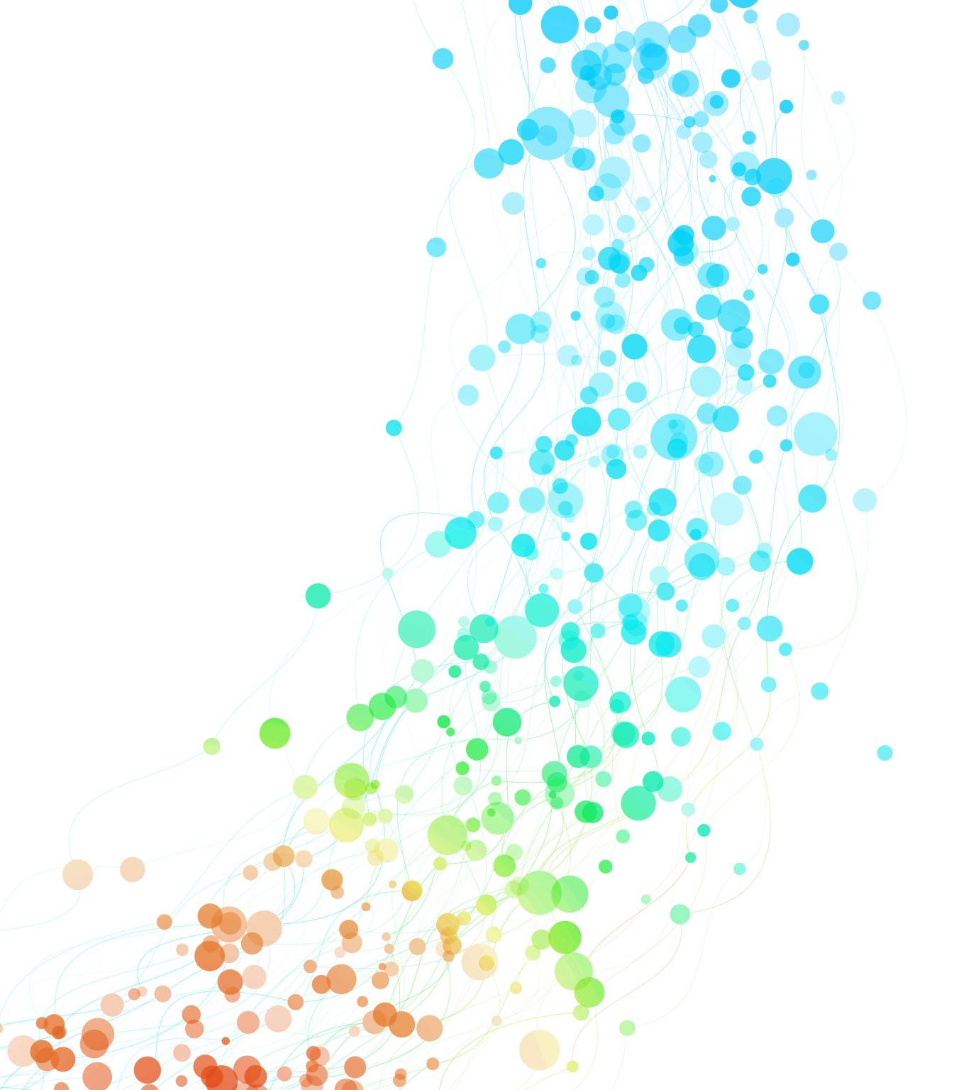
Views, Models and Templates

Slide 2
Understanding the workflow
We need to first understand how the components work together when a site managed by Django is accessed
Having a clear understanding of the working of nuts and bolts will make it easier to understand the overall design of any application that we will make
A site made by Django is actually a collection of different applications where each application is a collection of different webpages
So we must begin from the starting point and that being, what happens when a user opens the very first page of an application which is normally index.html

Slide 3
HttpRequest and HttpResponse
When a page is requested, Django creates an HttpRequest object that contains metadata about the request
It is a request/response cycle where a request must be followed by a response known as HttpResponse object
But how to manage the request? And what response should be returned? And how can this be done?
Since the request is generated by what is viewed by the user and the response is also viewed by the user, it only makes sense that this processing happens in views.py file
The views.py file contains specific functions which handle the specific responses. Thus, a request generated by the index page is generally handled by the index function, and a request generated by the about page is generally handled by the about function and so on. Keeping the names of the functions as that of the pages reduces confusion.
But how does Django know which function to call for which request?

Slide 4
Reading the URL
When Django receives an HTTP request it parses it, uses some of the URL for routing purposes and passes parts of the URL to your code
Django Application (also folder)
Domain Name
View within application
https://mysite.com/polls/about
https://mysite.com/polls/about?guess=42
https://mysite.com/polls/about/24
Key / value parameter (GET)
URL Path Parameter

Slide 5
Three patterns of Views
Requests are routed to a pre-defined class from Django itself
Requests are routed to a function in views.py (something that we will be doing in our polls app) that takes the http request as a parameter and returns a response
Requests are routed to a class in views.py (A more powerful methodology as it uses various OOP techniques) that has get() and post() methods that take the http request as a parameter and return a response

Slide 6
Writing the first view
Open the file polls/views.py and put the following Python code in it:
from django.http import HttpResponse
def index(request):
return HttpResponse("Hello, world. You're at the polls index.")
Which means that whenever the index page or the main page of the polls application is requested, it will return an HttpResponse object that will contain all the meta data that goes into creating the index view.
In this case the view is a text line with two sentences

Slide 7
Multiple views in views.py
We should keep in mind that this one file can contain multiple functions
Every function defines the view of every web page that we see
Hence the polls app must know which function to call when a page is requested
That is why we define this information in urls.py which manages all the pages within the polls app

Slide 8
URL Patterns of Polls
In the polls directory, create the file urls.py and write the following code:
from django.urls import path
from . import views
urlpatterns = [
path("", views.index, name="index"),
]
This signifies that the function index must be called within views.py whenever the index.html is requested

Slide 9
URL Patterns of mysite
You also need to tell mysite what to do if a request comes in from within its many applications. Thus, you need to updates its own mysite/urls.py file with the following code:
from django.contrib import admin
from django.urls import include, path
urlpatterns = [
path("polls/", include("polls.urls")),
path("admin/", admin.site.urls),
]
So now it will refer to the urls.py file of polls whenever a request for it is received

Slide 10

Testing it out
to launch the server while using a terminal or shell, type in:
$ python manage.py runserver
If you are working on python anywhere, you must relaunch the server by pressing the following button:
If you are working on the shell or terminal, go to http://localhost:8000/polls/
If you are working on python anywhere, go to <username>.pythonanywhere.com/polls/ and check the output

Slide 11
Upgrading the first view
We further upgrade the response object by adding a bit of HTML … it however does not give us the result that we want:
from django.http import HttpResponse
def index(request):
return HttpResponse(“<h1>Hello, world. <p>You're at the polls index.</p>")
You can see that the HTML syntax is not complete and yet it works … although the view is a little bit not like what we want
This disregard of syntax is intentionally overlooked by the browsers as the aim is to give proper information and the styling can be investigated later. \

Slide 12
Upgrading the first view to proper HTML
<!DOCTYPE html>
<html>
<head>
</head>
<body>
<h1>Hello, world</h1>
<p>You're at the polls index.</p>
</body>
</html>
We change the text into proper hypertext to define our index.html page
We can still make it shine a bit better by adding a bit of CSS

Slide 13
Upgrading the first view with CSS
<!DOCTYPE html>
<html>
<head>
<style>
h1 { color: blue; text-align: center;}
</style>
</head>
<body>
<h1>Hello, world</h1>
<p>You're at the polls index.</p>
</body>
</html>
You may need to write this text in a line within the python function to make it work properly

Slide 14
Structuring the data (Making models)
Having a collection of data is the first step into making a meaningful website
To provide meaning, we need to organize the data in such a way that it is easily accessible and makes sense
We do this by arranging the data into tables and then making connections between the tables, which is the core of the RDBMS model
Luckily, we can do this from within Django by using python through the models.py file
We define the model by defining classes for each table. This helps in creating a database at the backend when we make migrations

Slide 15
views.py
Index Page
About page
Page defined as function
def index(request):
…
Question
models.py
Table defined as class
class Question(models.Model):
…

Slide 16
Creating models
from django.db import models
class Question(models.Model):
question_text = models.CharField(max_length=200)
pub_date = models.DateTimeField("date published")
class Choice(models.Model):
question = models.ForeignKey(Question, on_delete=models.CASCADE)
choice_text = models.CharField(max_length=200)
votes = models.IntegerField(default=0)

Slide 17
Setting up all the Applications
A Django project may have multiple applications and you may want to use some of these applications in your project
You add the name of these applications in the mysite/settings.py file
Just add “polls” in the list of applications given in the INSTALLED_APPS list
INSTALLED_APPS = [
'django.contrib.admin', 'django.contrib.auth', 'django.contrib.contenttypes', 'django.contrib.sessions', 'django.contrib.messages', 'django.contrib.staticfiles’, 'polls.apps.PollsConfig',
]

Slide 18
Making classes useful
Using classes to define models has some hidden advantages as we can define functions that can give us additional information. For example, if we define a question in the database and then try to view it, it just returns the question object. We can create a function that returns the text of the question when we return the Question object, thus letting us know what questions are present in the database. We do this by defining the __str__ function within the Question class
def __str__(self): return self.question_text
We can also get the publication data through another function:
def was_published_recently(self):
return self.pub_date >= timezone.now() - datetime.timedelta(days=1)

Slide 19
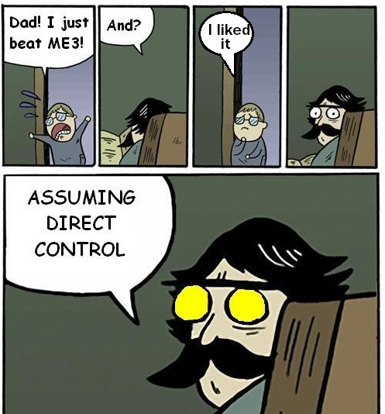
Assuming Direct Control (Admin)

Slide 20
The Administrator
While creating your web application, you may create the data to be added to your database or link a created database to your web application
To add or remove data, you can use the shell to do so at the back end or you can work with the admin interface that is provided by Django itself
Django was written in a newsroom environment, with a very clear separation between “content publishers” and the “public” site.
Hence, we need site managers that can quickly add or remove content to the site for the site visitors to view. Django entirely automates creation of admin interfaces for models.
The site manager is normally called an admin

Slide 21
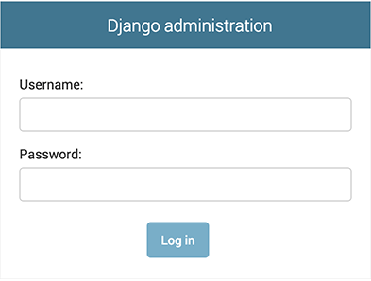
Logging in as Administrator
You go to <username>.pythonanywhere.com/admin/ to log in as admin, if you are using a local server, then go to http://127.0.0.1:8000/admin/
If you have already created a superuser, then you can log in with that profile from the admin’s login screen

Slide 22
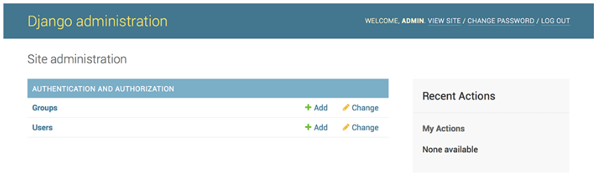
Where is my Polls app?
Whatever Table you want to update you need to register its class with the admin
Even though this lets the admin update data, but the overall control can still be made limited, thus ensuring that the administrator does not end up making mistakes that are unrecoverable.

Slide 23
Making Polls app modifiable
open the polls/admin.py file, and edit it to look like this:
from django.contrib import admin from .models import Question
admin.site.register(Question)
Once the Question class has been registered, it lets the admin add/remove/edit the objects of the Questions table
Keep in mind that the classes define the model, hence registering them lets the admin view their data

Slide 24
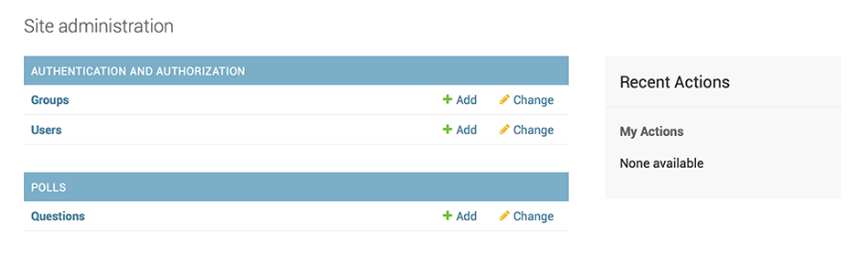
We can now work with Questions

Slide 25
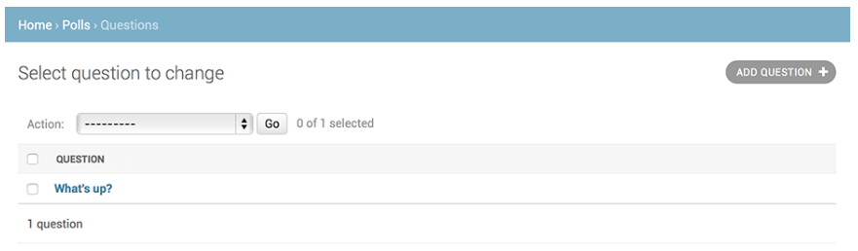
The admin can now change any Question

Slide 26
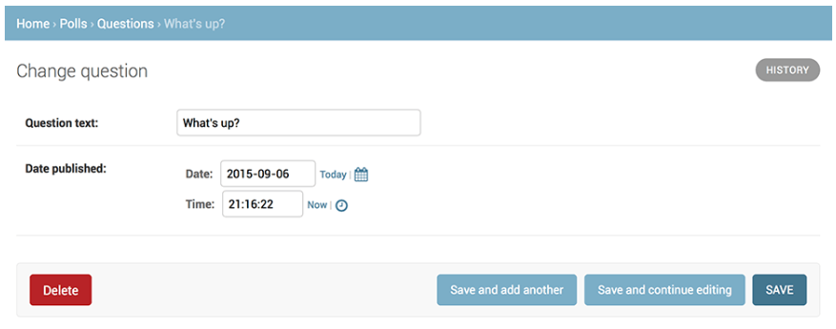
Internal details are shown as per attributes in model

Slide 27
Putting what we learned to good use
We will be making new views
We will be working with templates to display the views
We will use Django’s URL configurations ‘URLconfs’ to link URL patterns to views

Slide 28
Making Views
Define the following views in views.py file
def detail(request, question_id): return HttpResponse(“You're looking at question %s.”% question_id)
def results(request, question_id): response = “You're looking at the results of question %s.” return HttpResponse(response % question_id)
def vote(request, question_id): return HttpResponse(“You're voting on question %s.”% question_id)

Slide 29
Types of HttpResponse
http://www.mysite.com/page1.html - 200 OK
http://www. mysite.com/page2.html- 404 Not Found
500 Server Error
http://www.mysite.org/ - 302 Found / Moved (which means that a redirection has happened)
https://en.wikipedia.org/wiki/List_of_HTTP_status_codes

Slide 30
Mapping URLs
Add the following code to urls.py in the polls folder
from django.urls import path
urlpatterns = [
path(“”, views.index, name = 'index’ ), path( ‘<int:question_id>/’, views.detail, name = ‘detail’), path( ‘<int:question_id>/results/’, views.results, name = ‘results’ ), path( ‘<int:question_id>/vote/’, views.vote, name = ‘vote’ ),
]

Slide 31
Writing a meaningful view
The following code displays the latest 3 poll questions in the system, separated by commas, according to publication date but it is hardcoded
def index(request): latest_questions = Question.objects.order_by('-pub_date')[:3] output = ', '.join([q.question_text for q in latest_questions]) return HttpResponse(output)
The aim always is to keep the content as dynamic as possible as it makes it easier to update
We do this by using Templates

Slide 32
Writing a Template
Create a templates folder within the mysite folder
Create a polls sub-folder within the templates folder to allow for multiple applications
In that sub-folder, create a file index.html and add the following code:
{% if latest_question_list %}
<ul>
{% for question in latest_question_list %}
<li><a href="/polls/{{ question.id }}/">{{ question.question_text }}</a></li>
{% endfor %}
</ul>
{% else %}
<p>No polls are available.</p>
{% endif %}

Slide 33
Locating your Templates folder
Add the following to settings.py:
TEMPLATE_DIR = os.path.join(BASE_DIR, 'templates')
TEMPLATES = [{
'BACKEND':...
'DIRS': [TEMPLATE_DIR,],
... }]

Slide 34
Changing the index view to use the template
from django.shortcuts import render
def index(request): latest_questions = Question.objects.order_by ('-pub_date')[:3] context = {'latest_question_list': latest_questions} return render(request, 'polls/index.html', context)

